Slide 1
Data Structure and Algorithm Analysis
Alemitu Mequanint
Addis Ababa Science & Technology University
2010 E.C., Semester I

Slide 2
More on Asymptotic Analysis
Outline:
Growth Rate
Best, Average & Worst Cases
Upper Bound, Lower Bound, Theta Notation

Slide 3
Asymptotic Analysis:
Estimates the time or space required by a program as function of the input size
We analyze:
time required for an algorithm
the space required for a data structure.

Slide 4
Growth Rate
The growth rate for an algorithm is the rate at which the cost of the algorithm grows as the size of its input grows.
Examples:
T(n) | Type
c | constant
log n | logarithmic
n | linear
n log n | "n log n"
n² | quadratic
n³ | cubic
2^{n} | exponential

Slide 5
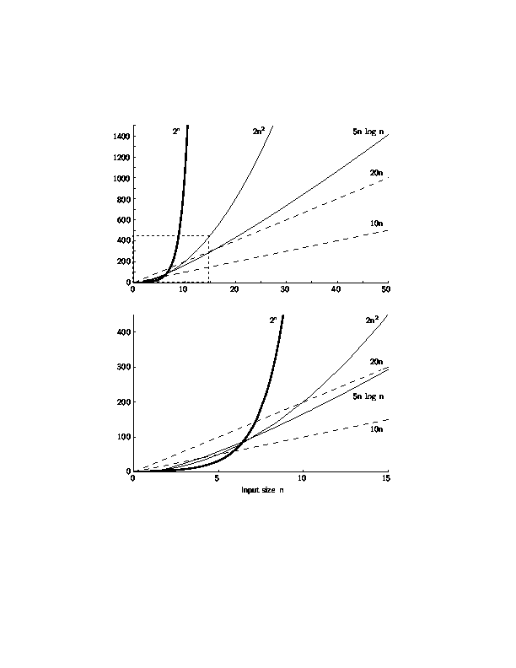
Growth Rate Graph

Slide 6
Best, Worst and Average Cases
Largest-value sequential search algorithm - always examines every array value.
However, for some algorithms, different inputs require different amounts of time.
E.g. Sequential search for K in an array of n integers:
Begin at first element in array and look at each element in turn until K is found
Best case: Find at first position. Cost is 1 compare.
Worst case: Find at last position. Cost is n compares.
Average case:(n+1)/2 compares if we assume the element with value K is equally likely to be in any position in the array.

Slide 7
Asymptotic Analysis: Upper Bounds
Several terms are used to describe the running-time equation for an algorithm.
Upper bound - indicates the upper or highest growth rate that an algorithm can have.
measured on the best-case, average-case, or worst-case inputs
Big-Oh notation:
If the upper bound for an algorithm’s growth rate (say, the worst case) is f(n), then this algorithm is “in the set O(f(n))in the worst case”
(or just “in O(f(n))in the worst case”).

Slide 8
Asymptotic Analysis: Big-oh Notation
Definition: For T(n) a non-negatively valued function, T(n) is in the set O(f(n)) if there exist two positive constants c and n₀ such that T(n) <= cf(n) for all n > n₀.
n₀ is the smallest value of n for which the claim of an upper bound holds true.
Usage: The algorithm is in O(n²) in [best, average, worst] case.
[Must pick one of these to complete the statement. Big-oh notation applies to some set of inputs.]
Meaning: For all data sets big enough (i.e., n>n₀), the algorithm always executes in less than c f(n) steps in [best, average, worst] case.
Notes:
Must pick one of [best, average, worst] to complete the statement. Big-oh notation applies to some set of bounds.

Slide 9
Big-oh Notation (cont.)
Big-oh notation indicates an upper bound.
T(n) grows at a rate no faster than f (n)
…“is in O(f(n))” or “ Є O(f(n))”, no strict equality actually
Example: If T(n) = 3n² then T(n) is in O(n²).
Wish tightest upper bound:
While T(n) = 3n² is in O(n³), we prefer O(n²).
Notes:
It provides more information in this example to say O(n²) than O(n³).

Slide 10
Big-Oh Examples
Example 1: Finding value X in an array (average cost, assuming equal probability of appearing in any position).
T(n) = c_{s}n/2.
For all values of n > 1, c_{s}n/2 <= c_{s}n.
Therefore, by the definition, T(n) is in O(n) for n₀ = 1 and c = c_{s}.
Notes:
We are doing average case.
c_{s} is a constant. The actual value is irrelevant.

Slide 11
Big-Oh Examples
Example 2: T(n) = c₁n² + c₂n in average case.
c₁n² + c₂n <= c₁n² + c₂n² <= (c₁ + c₂)n² for all n > 1.
T(n) <= cn² for c = c₁ + c₂ and n₀ = 1.
Therefore, T(n) is in O(n²) by the definition.
Example 3: T(n) = c. We say this is in O(1).

Slide 12
A Common Misunderstanding
“The best case for my algorithm is n=1 because that is the fastest.” WRONG!
Big-oh refers to a growth rate as n grows to ∞.
It states a claim about the greatest amount of some resource (usually time) that is required by an algorithm for some class of inputs of size n (typically the worst such input, the average of all possible inputs, or the best such input).
Best case is defined as which input of size n is cheapest among all inputs of size n.
Notes:
We are doing average case.
c_{s} is a constant. The actual value is irrelevant.

Slide 13
Lower Bound
Describes the least amount of a resource that an algorithm needs for some class of input.
Like big-Oh notation, this is a measure of the algorithm’s growth rate.
Measured for some particular class of inputs:
the worst-, average-, or best-case input of size n.

Slide 14
Big-Omega
Definition: For T(n) a non-negatively valued function, T(n) is in the set Ω(g(n)) if there exist two positive constants c and n₀ such that T(n) >= cg(n) for all n > n₀.
Meaning: For all data sets big enough (i.e., n > n₀), the algorithm always executes in more than cg(n) steps.
wish to get the “tightest” (for Ω notation, the largest) bound possible.

Slide 15
Big-Omega Example
T(n) = c₁n² + c₂n.
c₁n² + c₂n >= c₁n² for all n > 1.
T(n) >= cn² for c = c₁ and n₀ = 1.
Therefore, T(n) is in Ω(n²) by the definition.
We want the greatest lower bound.

Slide 16
Theta Notation
When big-Oh and Ω meet, we indicate this by using Θ (big-Theta) notation.
Definition: An algorithm is said to be Θ(h(n)) if it is in O(h(n)) and it is in Ω(h(n)).
For polynomial equations on T(n), we always have Θ. There is no uncertainty, since once we have the equation, we have a “complete” analysis.
Notes:
For polynomial equations on T(n), we always have Θ. There is no uncertainty, since once we have the equation, we have a “complete” analysis.

Slide 17
A Common Misunderstanding
Confusing worst case with upper bound:
Upper bound refers to a growth rate.
Worst case refers to the worst input from among the choices for possible inputs of a given size.

Slide 18
Simplifying Rules
(1) If f(n) is in O(g(n)) and g(n) is in O(h(n)),
then f(n) is in O(h(n)).
[if some function g(n) is an upper bound for your cost function, then any upper bound for g(n) is also an upper bound for your cost function.]
(2) If f(n) is in O(kg(n)) for any constant k > 0,
then f(n) is in O(g(n)). [Ignore constants]
(3) If f₁(n) is in O(g₁(n)) and f₂(n) is in O(g₂(n)),
then (f₁ + f₂)(n) is in O(max(g₁(n), g₂(n))).
[Given two parts of a program run in sequence consider only the more expensive part. Drop lower order terms]
(4) If f₁(n) is in O(g₁(n)) and f₂(n) is in O(g₂(n)) then f₁(n)f₂(n)
is in O(g₁(n)g₂(n)).
[If some action is repeated some number of times, and each repetition has the same cost, then the total cost is the cost of the action multiplied by the number of times that the action takes place. Useful for analyzing loops]
Notes:
2. Ignore constants.
3. Drop low order terms.
4. Useful for analyzing loops.

Slide 19
Simplifying Rules (cont.)
Taking the first three rules, ignore all constants and all lower-order terms to determine the asymptotic growth rate for any cost function.
The higher-order terms soon swamp the lower-order terms in their contribution to the total cost as n becomes larger.
Example: if T(n) = 3n⁴ +5n², then T(n) is in O(n⁴). n² contributes relatively little to the total cost.

Slide 20
Running Time Examples (1)
[Asymptotic analysis is defined for equations. We need to convert programs to equations to analyze them.]
Example 1: a = b;
[This assignment takes constant time, so it is Θ(1).]
Example 2:
sum = 0;
for (i=1; i<=n; i++)
sum += n;
[1st line is Θ(1). The for loop is repeated n times. 3rd line takes constant time so, by rule (4), total cost for the two lines is Θ(n). By rule (3), the cost of the entire code fragment is also Θ(n).]
Notes:
Asymptotic analysis is defined for equations. We need to convert programs to equations to analyze them.
The traditional notation is Θ(1), not Θ(c).
Θ(n) even though the value of sum is n².

Slide 21

Running Time Examples (2)
Example 3:
sum = 0;
for (i=1; i<=n; j++) //first for loop
for (j=1; j<=i; i++)// is double loop
sum++;
for (k=0; k<n; k++)//second for loop
A[k] = k;
[First statement is c₁ =>Θ(1).
Double for loop :
- sum++ requires constant time,c₂
- inner for loop is executed i times, by rule (4), c₂i
- outer for loop is executed n times, but each time the cost
of the inner loop is different ,c₂i with i changing each time.
-Thus, the total cost of the loop is c₂ times the sum of the
integers 1 through n: => Θ(n²).
Final for loop is c₃n = Θ(n) time Θ(n). Result: Θ(n²).]
Notes:
First statement is Θ(1). Double for loop is Σi = Θ(n²). Final for loop is Θ(n). Result: Θ(n²).

Slide 22
Running Time Examples (3)
Example 4: Compare.
sum1 = 0;
for (i=1; i<=n; i++)
for (j=1; j<=n; j++)
sum1++;
sum2 = 0;
for (i=1; i<=n; i++)
for (j=1; j<=i; j++)
sum2++;
[First loop, sum is n². Second loop, sum is (n+1)(n)/2. Both are Θ(n²).]
In the first double loop, the inner for loop always executes n times
In the second double loop, the inner for loop always executes i times
Notes:
First loop, sum is n². Second loop, sum is (n+1)(n)/2. Both are Θ(n²).

Slide 23
Other Control Statements
while loop: Analyze like a for loop.
if statement: Take greater complexity of then/else clauses.
[The probabilities for the then/else clauses being executed must be independent of n.]
switch statement: Take complexity of most expensive case.
Function call: add the cost of the subroutine.
Notes:
if statement: The probabilities for the then/else clauses being executed must be independent of n.
switch statement: The probabilities of the various clauses being executed must be independent of n.

Slide 24
Space Bounds
Space bounds can also be analyzed with asymptotic complexity analysis.
Time: Algorithm
Space: Data Structure
[While time requirements are normally measured for an algorithm that manipulates a particular data structure, space requirements are normally determined for the data structure itself.]
A data structure’s primary purpose is to store data in a way that allows efficient access to those data.
To provide this, it stores additional information where the data are - overhead

Slide 25
Space/Time Tradeoff Principle
One can often reduce time if one is willing to sacrifice space, or vice versa.
Encoding or packing information:- reduces storage, but Unpacking” or decoding the requires additional time.
Lookup Table: for calculating factorials
[For a program that often computes factorials, it is likely to be much more time efficient to simply pre-compute the storable values in a table (up to 12! for 32-bit int)]
Disk-based Space/Time Tradeoff Principle: The smaller you make the disk storage requirements, the faster your program will run.

